Slide 1
Lunar Alloy Metal Production Plant (LAMPP) NASA 2023 Big Idea Challenge
Lunar Surface Innovation Consortium (LSIC) Telecon
16 August 2023
Team Members
Faculty Advisors
Christopher Dreyer, PhD: Professor of Practice – Colorado School of Mines – Space Resources
George Sowers, PhD: Professor of Practice – Colorado School of Mines – Space Resources
Wesley Butler
Peter Corwin
Kyla Edison
Gustavo Jamanca-Lino
Ian Jehn
Daniel McConville
David Purcell
Adam Williams
Industry Advisor
Laurent Sibille, PhD: Sr. Technology Development Scientist
Facility Advisor:
Sarah Harling: Foundry Advisor – Colorado School of Mines – Metallurgical and Materials Engineering
Contributors: Valerie Svaldi

Slide 2
Agenda
LAMPP Concept
Objectives
Testing – Refractory Materials
Preliminary Results
On-Going Work
Questions

Slide 3
LAMPP Concept
The Lunar Alloy Metal Production Plant (LAMPP) is a self-contained, scalable, deployable metal production system designed for use in the lunar environment.
Molten Regolith Electrolysis (MRE) passes an electric current through molten regolith to split oxygen from metal oxides to control production rates of oxygen and high-quality metal.

Slide 4
Lunar Highlands Regolith Input
Key Assumption
$${SiO}_{2},{ Al}_{2}O_{3},CaO, FeO, MgO,TiO_{2 }$$
Interface System (Out of Scope)
Particle Size Screening
Gangue Material
Large Rocks & Agglutinates
1st Major Processing Step: Si & Mg
Beneficiation Process
2nd Major Processing Step: Ti & Al
Magnetic Separation
$$FeO$$
Magnetic Iron Oxides
Subsystem
Non-magnetic material
$${CaO, MgO, Al}_{2}O_{3},$$
$$TiO_{2, }\text{Si}O_{2}$$
Metal Stock Material Production Subsystem
Oxygen Byproduct
Molten Regolith Electrolysis
Silicon & Magnesium Reduction
Separation of Silicon & Magnesium
Metal Refinement
Cast Si Cast Mg
Unreduced Oxides
${Al}_{2}O_{3}, TiO_{2}$
Batch Transfer Subsystem
Batch Transfer Subsystem
Unreduced Oxide Byproduct
(Slag)
Molten Regolith Electrolysis
Titanium & Aluminum
Separation of Titanium & Aluminum
Metal Refinement
Cast Ti
Cast Al
$${CaO, MgO, MnO,Na2O,other}_{}$$
MRE Control Subsystem
Metal Refinement Subsystem
Notes:
Support images

Slide 5
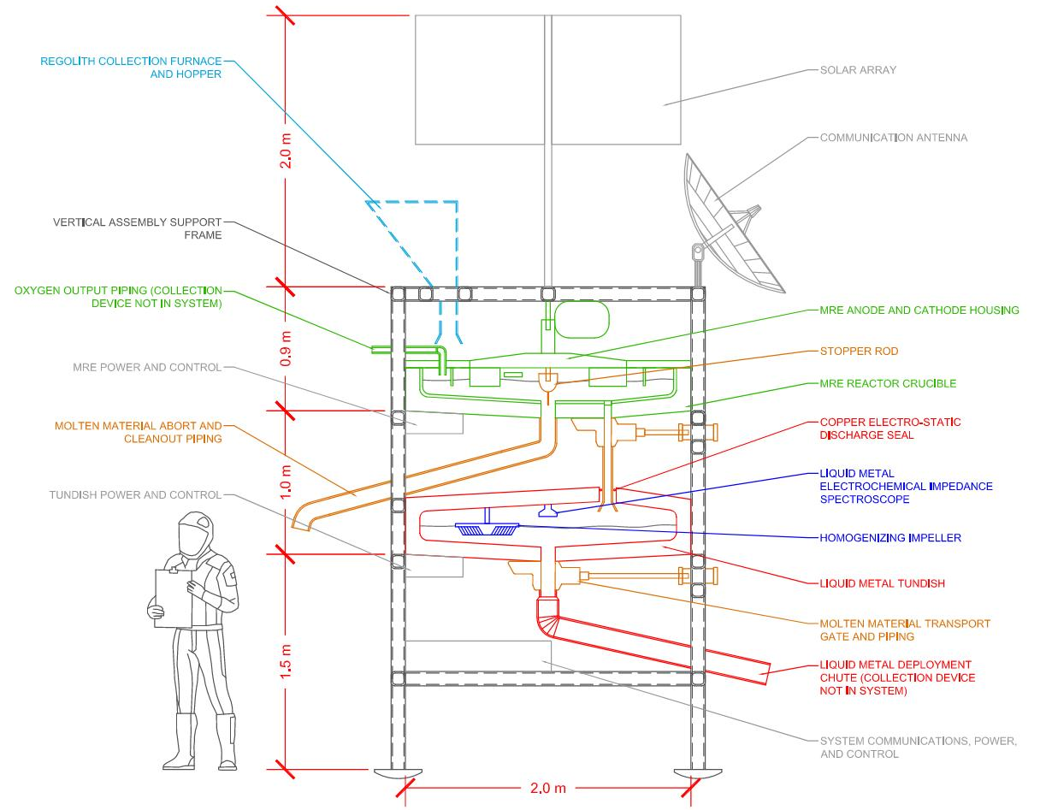
LAMPP Concept

Slide 6
Objectives
Unify what is known about MRE and associated technologies in the form of a review paper. This includes a literature review of known refractory material performance.
Test and select refractory materials as containment for molten regolith of highlands and mare compositions considering qualities such as longevity, robustness, and corrosion resistance .This includes dipstick, crucible, and molten flow over plate testing.
Understand and build a reference for how metals flow at high temperatures in vacuum and how refractory materials and gravity may be impacted.

Slide 7
Testing – Refractory Materials
Various refractory materials were chosen after a down-selection process, which included analyzing factors such as:
Corrosion Resistance
Material Cost
Material Availability
Three Benchmark geometries were chosen for testing:
Rods
Crucibles
Plates

Slide 8
Testing – Refractory Materials
Rod testing involves submerging candidate refractory materials in regolith melts, with varying chemistries to represent highland and mare source material.
Rods held in melt for 45 mins – 1 hr.
Surviving rods under-going inspection for damage, material loss, and microstructure impingement/growth.

Slide 9
Testing – Refractory Materials

Slide 10
Testing – Refractory Materials

Slide 11
Preliminary Results

Slide 12
On-Going Work
Analysis of previously tested rods.
SEM Imaging at Mines.
Application of refractory coatings on tested rods.
Boron Nitride (BN) coatings on SiC, and Molybdenum (Mo) rods.
Initial testing of COTS crucibles
SiC, SiC+BN Coating, Mo, Mo+BN Coating, BN
Initial testing of COTS plates
Awaiting down-select

Slide 13
On-Going Work
Development of a lunar-scale system-level product, which provides information on:
Final refractory material selection(s).
Mass of LAMPP Components.
Lifetime of LAMPP Components.
Cost of LAMPP Components.
Source: https://www.nasa.gov/feature/nasa-seeks-student-ideas-for-extracting-forging-metal-on-the-moon

Slide 14
Questions?

Slide 15
Backup
References:
ASM Handbook Committee. (2018). ASM International (pp. 1099–1201.
Carol, E. (2019) Space Resources Roundtable.
Curreri, P. A. et al. (2006). MSFC Independent Research and Development Project No. 5-81.
Grossman, K.D. et al. (2021) ASCEND 2021 (p. 4019).
Naser, M. Z. (2019). Progress in Materials Science (Vol. 105).
Sadoway, D. (2005). Lunar Regolith Simulant Materials Workshop.
Schreiner, S et al. (2016).
Advances in Space Research, 57(7), 1585–1603.
Sibille, L., and Sadoway, D. (2009). Space Propulsion and Energy Sciences International Forum.
Sibille, L., and Dominguez, J. A. (2012). Production on the Moon and Mars.
Sirk A. H. et al. (2010). ECS Transactions, 28(6), 367–373. [11] Standish, E. et al. (2010). Graduate Program in the Department of Materials Science and Engineering, The Ohio State University.

Slide 16
Backup

Slide 17
Backup: Candidate Materials for LAMPP

Slide 18
Backup: Risk Matrix

Slide 19
Backup: Risk Square

